Slide 1

Ratings Systems Utilizing Numerical Sims & The Chess Player Population
Mathematical Modelling
MA680 Final Presentation
Douglas Bowen

Slide 2



The Basics of Ratings
Absolutely Bare-Bones Information
All Players Have a Rating
Higher Ratings > Lower Ones
Ratings Are Updated
All players have a numerical rating that “reflects” their expected skill level.
A player with a higher rating is expected to beat one with a lower rating, on average.
After completing a “match” or series of matches, those involved have their ratings updated.

Slide 3
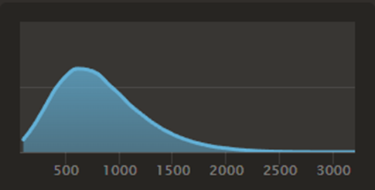
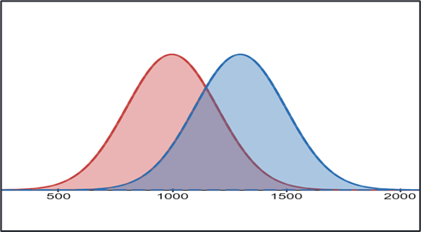
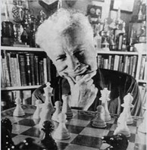

The Basics of Ratings
Just a Little More Information
All Players Have a Rating
Higher Ratings > Lower Ones
Ratings Are Updated
In Chess, official FIDE ratings range from 100 to around 2900, but could theoretically tend towards infinity.
The current distribution of players follows a lognormal one.
A higher rated player will, on average, win against a lower rated player.
We can model this with a probability distribution.
There are currently two rating systems that are quite popular: 1) The “Elo” Rating System
2) The “Glicko” Rating System
We’ll focus on the “Elo” Rating System for this presentation.

Slide 4

Key Assumptions
Statistical and Other
Performance Assumptions
Other Assumptions
A player’s performance behaves like a random variable.
A player’s performance conforms to a bell-curve shaped probability distribution.
A player’s mean performance changes over time, but slowly.
A player’s performance conforms to a Logistic Distribution.
A player's skill does not change over time away.
There is no advantage based on player side – white versus black.
Notes:
1m43s to get through to/past this slide

Slide 5
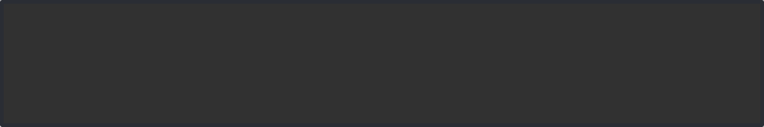

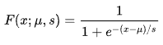
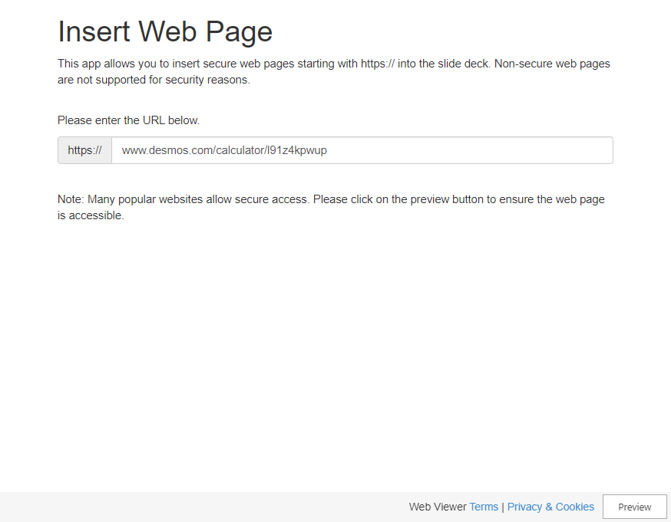
What are the Odds?
With these assumptions on player performance, we can calculate the probability of a player winning.
The CDF of the Logistic Distribution:
Gives: P(x < u) at scale s
Which Equates to:
P(R_{B} < R_{A}) or P(A Wins)
P(B Wins) = 1 – P(A Wins)
Notes:
0 = equal, 100 = 2x, 200 = 3x, 300 = 6x, 400 = 10x
Logistic Function, Sigmoid Curve
Numerator 1 = L = Curve’s Maximum Value
K = 1/s = Logistic Growth Rate/Steepness of Curve
X_0 = X Value of Midpoint of Function

Slide 6

What are the Odds?
With these assumptions on player performance, we can calculate the probability of a player winning.
The CDF of the Logistic Distribution:
Gives: P(x < u) at scale s
Which Equates to:
P(R_{B} < R_{A}) or P(B Wins)
P(A Wins) = 1 – P(B Wins)
Notes:
To finish Odds slide takes 1m10s lets say 2m10s to be safe.
Logistic Function, Sigmoid Curve
Numerator 1 = L = Curve’s Maximum Value
K = 1/s = Logistic Growth Rate/Steepness of Curve
X_0 = X Value of Midpoint of Function

Slide 7
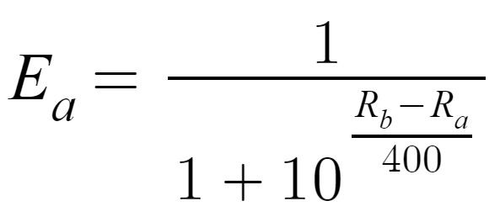
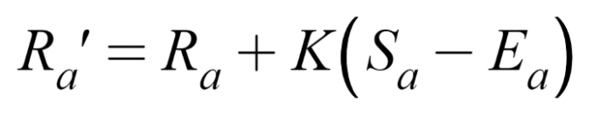
Elo’s Rating System
Tweaks to Expected Score and the Updated Rating Formula
The Updated Rating Formula
K = “Sensitivity”
Notes:
Reminder: Look at Multi-Match Pre Update Case

Slide 8



Elo’s Rating System
A Very Quick Example – An Expected Defeat
Factor | John Doe | Jane Doe
Initial Rating | 1000 | 1400
Expected Score “P(Win)” | 1/(1+10) = 1/11 = ~0.091 = ~9.1% | 1 – 0.091 = 0.909 = ~90.9%
Actual Score | Loss = 0 | Win = 1
Rating Adjustment | 32*(0 – 0.091) = ~-2.912 | 32*(1 – .909) = ~+2.912
New Rating | 997.088 | 1402.912
John Doe
Jane Doe
Rated: 1000
Rated: 1400

Slide 9
Elo’s Rating System
A Very Quick Example – An Unexpected Victory
Factor | John Doe | Jane Doe
Initial Rating | 1000 | 1400
Expected Score “P(Win)” | 1/(1+10) = 1/11 = ~0.091 = ~9.1% | 1 – 0.091 = 0.909 = ~90.9%
Actual Score | Win = 1 | Loss = 0
Rating Adjustment | 32*(1 – 0.091) = ~29 | 32*(1 – .909) = ~-29
New Rating | 1029 | 1371
John Doe
Jane Doe
Rated: 1000
Rated: 1400
Notes:
1m 16s from elo rating to end of here
4m10s lets say 5m10s or 6m10s to get to simulation point.

Slide 10


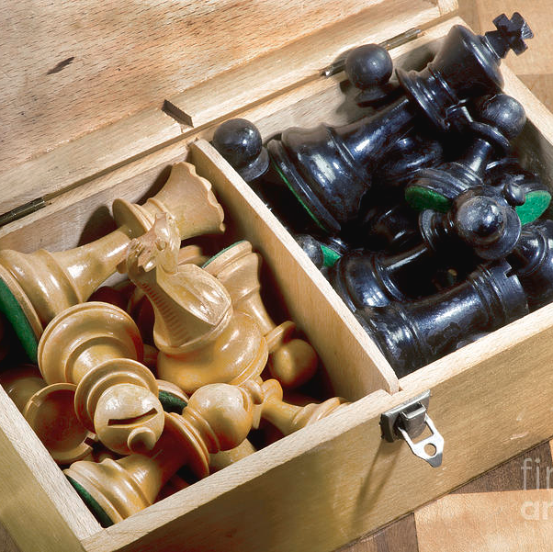
The Simulations
Two Scenarios, Numerous Changes
Grand Master Entry Scenario
One person.
One dream. A Pawn to a King.
Crush everyone.
How long will it take?
Population Initialization Scenario
So, you want to start your own site? You think you got what it takes?
Fresh Players.
Complete Unknowns.
Help them find where they belong, the quicker the better.

Slide 11






Simulation Factors
Impacting Both Scenarios
Simulations (n)
Matches (m)
Players (p)
Ratings (Public, Hidden)
Groupings (Y/N)
Anchors (Y/N)

Slide 12
Grandmaster
Results

Slide 13
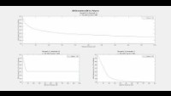
Grandmaster Scenario
Starting at a Public Rating of 600, True Rating of 2800
True Rating | Players | No Grouping | Grouping
2800 | 10 | 22.5% | 55%
 | 10000 | 20% | 0%

Slide 14
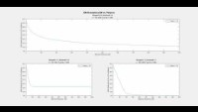
Grandmaster Scenario
Starting at a Public Rating of 600, True Rating of 2500
True Rating | Players | No Grouping | Grouping
2800 | 10 | 22.5% | 55%
 | 10000 | 20% | 0%
2500 | 10 | 15% | 50%
 | 10000 | 10% | 0%

Slide 15
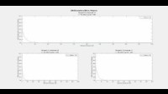
Grandmaster Scenario
Starting at a Public Rating of 600, True Rating of 1000
True Rating | Players | No Grouping | Grouping
2800 | 10 | 22.5% | 55%
 | 10000 | 20% | 0%
2500 | 10 | 15% | 50%
 | 10000 | 10% | 0%
1000 | 10 | 0% | 5%
 | 10000 | 0% | 0%

Slide 16
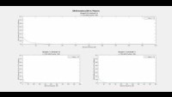
Grandmaster Scenario
Starting at a Public Rating of 600, True Rating of 500
True Rating | Players | No Grouping | Grouping
2800 | 10 | 22.5% | 55%
 | 10000 | 20% | 0%
2500 | 10 | 15% | 50%
 | 10000 | 10% | 0%
1000 | 10 | 0% | 5%
 | 10000 | 0% | 0%
500 | 10 | 0% | 10%
 | 10000 | 0% | 0%

Slide 17
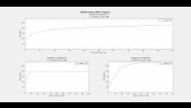
Grandmaster Scenario
Starting at a Public Rating of 600, True Rating of 2800
True Rating | Players | No Grouping | Grouping
2800 | 10 | N/A | N/A
 | 10000 | N/A | 350

Slide 18
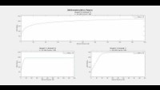
Grandmaster Scenario
Starting at a Public Rating of 600, True Rating of 2500
True Rating | Players | No Grouping | Grouping
2800 | 10 | N/A | N/A
 | 10000 | N/A | 350
2500 | 10 | N/A | N/A
 | 10000 | N/A | 200

Slide 19
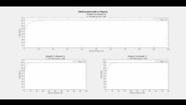
Grandmaster Scenario
Starting at a Public Rating of 600, True Rating of 1000
True Rating | Players | No Grouping | Grouping
2800 | 10 | N/A | N/A
 | 10000 | N/A | 350
2500 | 10 | N/A | N/A
 | 10000 | N/A | 200
1000 | 10 | 100 | N/A
 | 10000 | 100 | 75

Slide 20

Grandmaster Scenario
Starting at a Public Rating of 600, True Rating of 500
True Rating | Players | No Grouping | Grouping
2800 | 10 | N/A | N/A
 | 10000 | N/A | 350
2500 | 10 | N/A | N/A
 | 10000 | N/A | 200
1000 | 10 | 100 | N/A
 | 10000 | 100 | 75
500 | 10 | 150 | N/A
 | 10000 | 150 | 50

Slide 21
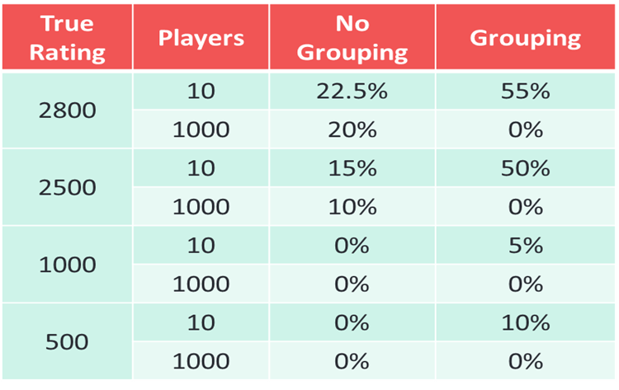
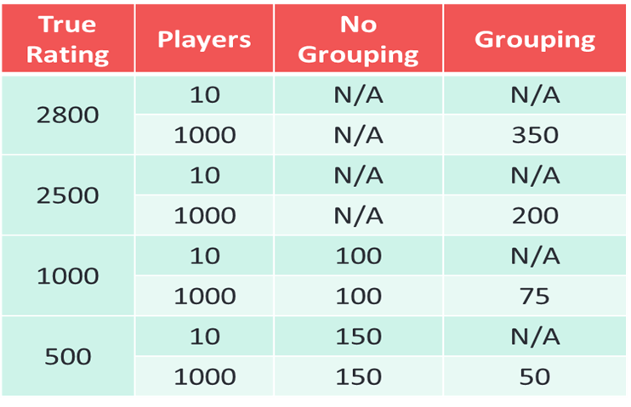
GM Scenario Takeaways
Insight we Can Draw
Error Rates
Matches Played to Reach Rating
The further from the mean rating, the more grouping hurts at low players.
The further from the mean rating, the more not grouping hurts at high players.
No grouping has little impact on error rate between low and high players (does not converge in either case).
At high player counts, grouping always converges faster than non-grouping.
At low player counts, grouping hinders convergence.
There is an equilibrium # of players where grouping/not-grouping produces the same results.

Slide 22
Fresh Pop.
Results

Slide 23
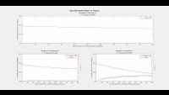
Population Initialization Scenario
Everyone Starts at a Public Rating ~U(0,2900)
Rating Method | Base Error
Random | 90%

Slide 24
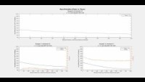
Population Initialization Scenario
Everyone Starts at a Public Rating Randomly ∈ {600, 1000, 1200}
Rating Method | Base Error
Random | 90%
Hybrid | 35%

Slide 25
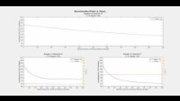
Population Initialization Scenario
Everyone Starts at a Public Rating Up to 30% Away From True Rating
Rating Method | Base Error
Random | 90%
Hybrid | 35%
Range 30 | 15%
Notes:
Range is better than hybrid until 70% Disparity

Slide 26
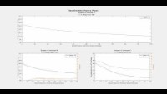
Population Initialization Scenario
Everyone Starts at a Fixed Public Rating of 1000
Rating Method | Base Error
Random | 90%
Hybrid | 35%
Range 30 | 15%
Fixed 1000 | 27%
Notes:
Range is better than hybrid until 70% Disparity

Slide 27
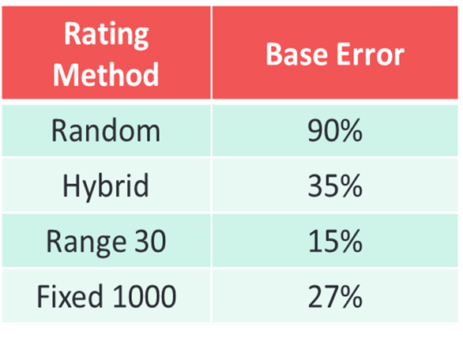
Population Initialization Takeaways
Insight we Can Draw
*
Initial Rating Settings
If players can somewhat accurately select their starting point, this is most efficient.
If not, setting everyone to 1000 is more effective.
Of similar effectiveness is setting 33% of the population to each of 600, 1000, 1200

Slide 28
Shortcomings & Important Notes
Simulation Based
Elo Rating Based
Ratings below 100 were allowed.
Anchors are not reasonable to expect.
Tournaments apply a round-robin method.
Error as a percentage can be misleading.
Ratings in different years, regions, & systems cannot be directly compared.
Advantage to white side exists.
Skill changes with time absent.

Slide 29
Thank you ☺
Questions?

Slide 30

Hidden
Appendices
Shh

Slide 31
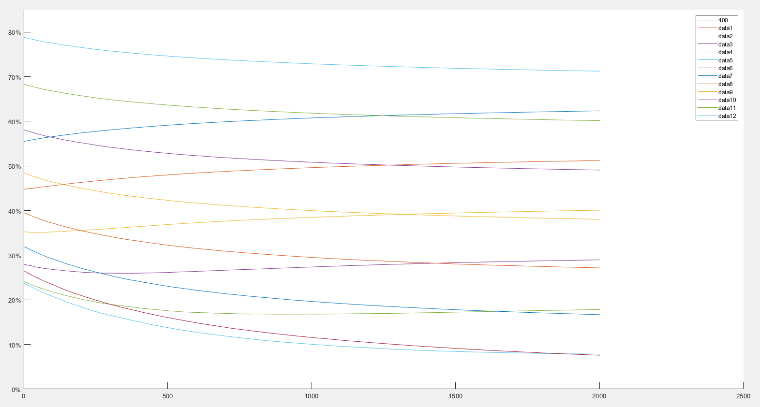
Population Initialization Scenario
Unique Fixed Rating Issues
1600
400
1500
Rating Method | Base Error
Random | 90%
Hybrid | 35%
Range 30 | 15%
Fixed 1000 | 27%
500
1400
600
1300
700
1200
800
1100
1000
900
Notes:
Range is better than hybrid until 70% Disparity

Slide 32


Other Uses
Two Other Quick Examples
Dating Apps
Video/Board Games

Slide 33

The Glicko-2 System
One major shortcoming of Elo’s rating system is that it assumes skill never changes with inactivity.
Factor | Elo System | Glicko-2 System
Rating Reliability | Always Reliable | Unreliable vs. Time
Update Requirements | Sensitivity “K” Constant Players’ Ratings Players’ Scores | Ratings Deviation Time t since last game Constant c Players’ RD’s Players’ Volatility Players’ Ratings Players’ Scores
Scenario:
Player A Plays Frequently
Player B Hasn’t Played in Years
Equally Matched (Rating A = Rating B)
Player B Wins
Is it fair that Player A loses as much as Player B gains?
New Info Under Glicko System:
Introduces “Rating Reliability”
Rating becomes “Best Guess”
Std Dev of Rating “Rating Deviation (RD)”
Rating can be constructed as a CI
Introduces “Fairness Factor”
Mitigated Loss for Inaccurate Ratings
Introduces “Volatility Factor”
Hot Streaks Increase Rating Increase

